Slide 1
Opportunities for Ship Leasing in GIFT - IFSC
October 2023

Slide 2
GIFT City: India’s 1st
Operational Smart City

Slide 3
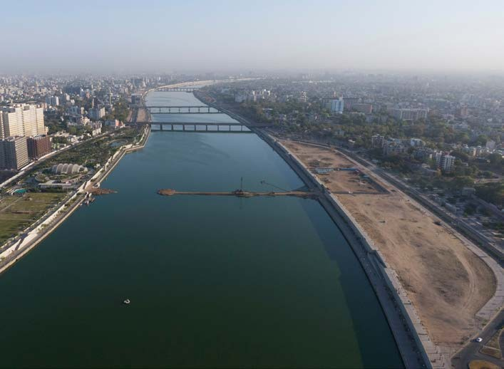
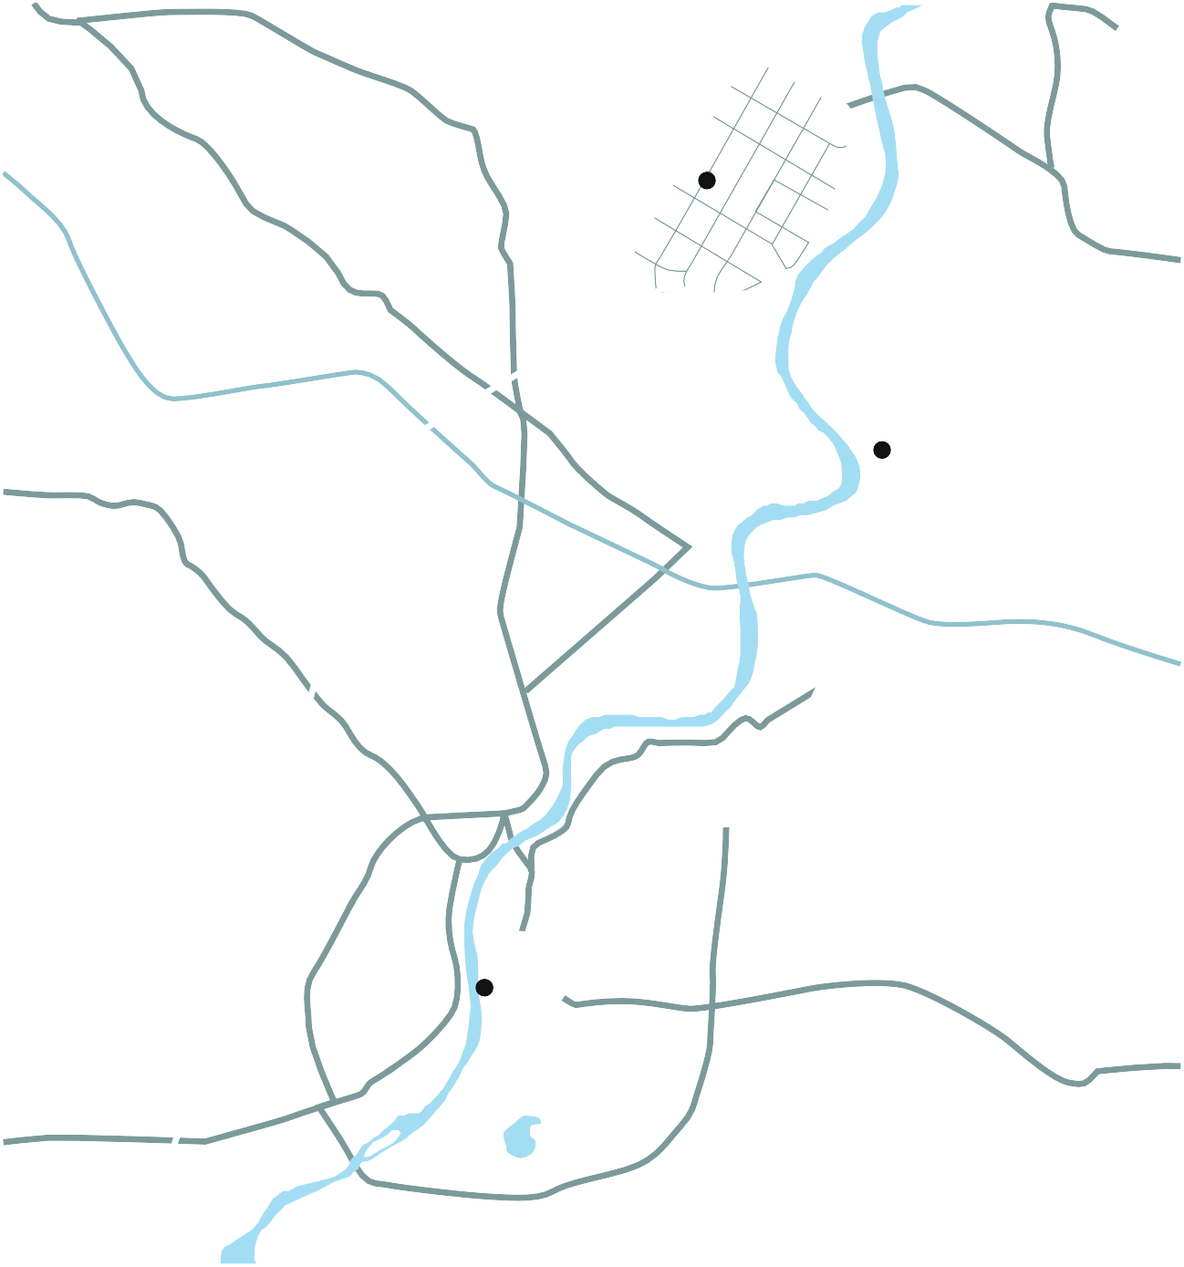
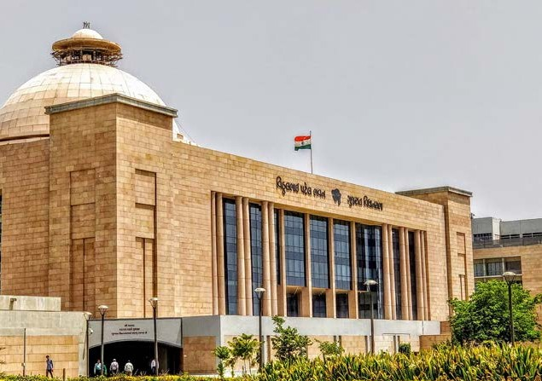
CONFLUENCE OF TRI-CITIES
Gandhinagar
GIFT City
Ahmedabad
20 Mins from Ahmedabad International Airport.
15 Mins from Nearest Railway Station.
Metro/E-Buses Connectivity to Ahmedabad
Mumbai Ahmedabad High Speed Bullet Train

Slide 4
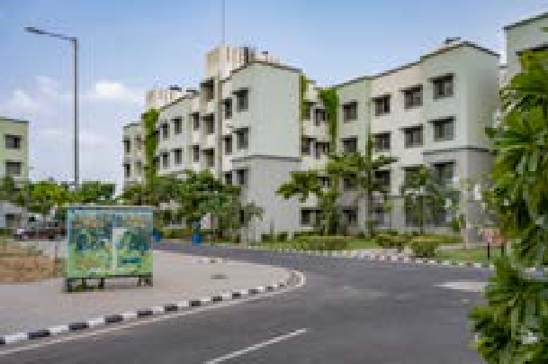
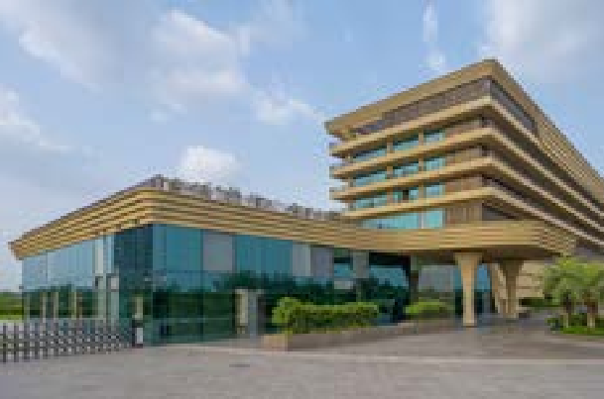
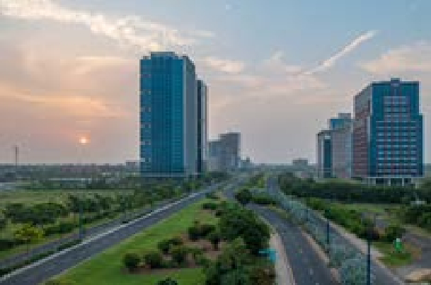
INTEGRATED DEVELOPMENT
COMMERCIAL BUSINESS DISTRICT
TECHNOLOGY
Smart & Intelligent offices
High-rise business district
Landmark building
Broadband FTTP
Shared IT services
Global connectivity
DEDICATED RESIDENTIAL ZONE
RETAIL CUM ENTERTAINMENT HUBS
Well planned residential areas
Walk-to-work
Affordable housing
High quality entertainment and recreational areas
Smart retail spaces, Restaurants and Sports areas
SOCIAL INFRASTRUCTURE
MOBILITY
External Connectivity includes MRTS / Roads
Efficient Public - Private Transportation
Dedicated Pedestrian Walkways
Dedicated Multilevel Parking
Educational Institutes
International & Domestic Schools
State-of-the-art healthcare
Universities / Training schools

Slide 5
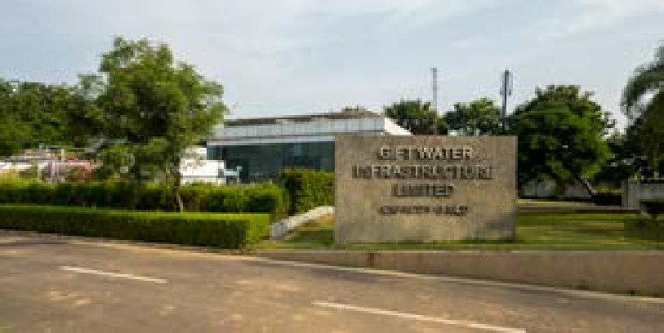
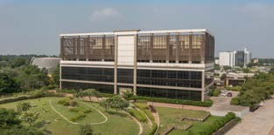
INFRASTRUCTURAL ADVANTAGE
UTILITY TUNNEL
POWER INFRASTRUCTURE
SMART WATER INFRASTRUCTURE
INDIA’S FIRST
DISTRICT COOLING SYSTEM
INDIA’S FIRST AUTOMATED WASTE MANAGEMENT
CITY COMMAND AND CONTROL CENTRE (C4)
HIGH SPEED BROADBAND CONNECTIVITY

Slide 6
IFSCA & GIFT IFSC Ecosystem

Slide 7
GIFT IFSC: Government of India Initiative
IFSC Authority Act, 2019 passed by Union Parliament
IFSCA issued 30 + Regulations Registered ≈ 550+ Entities
1ST Commercial building inaugurated at GIFT City
Jan. 2013
April 2015
Dec. 2019
Oct. 2020
Sept 2023
India’s 1st IFSC became operational with RBI, SEBI and IRDAI notifying regulations
IFSCA assumes power to develop and regulate IFSCs in India from 1st Oct 2020
1
IFSCA has been established as a unified financial regulator by the Government of India under the IFSCA Act, 2019
2
To develop and regulate IFSC’s in India, IFSCA has been vested with powers of four sectoral regulators namely- RBI*, SEBI*, IRDAI* & PFRDA*

Slide 8
Jurisdictional Comparison
FEMA
Currency
Tax
Law
Rest of the world
(Foreign Jurisdiction)
Offshore
Non-Resident
Respective
Int’l Currency
Offshore
Resident’s Jurisdiction
INDIA
IFSC
(SEZ)
Offshore
Non-Resident
11 Currencies
(₹ Not Permitted)
Tax Holiday
(Tax Resident)
Indian Jurisdiction
India
(DTA)
Onshore
Resident
Primary ₹ denominated
Taxes as applicable
(Tax Resident)
Indian Jurisdiction

Slide 9
Overview - IFSC
BUSINESS ACTIVITIES
BANKING
Indian Banks
Foreign Banks
Global Administrative Office
CAPITAL MARKET
Stock Exchanges
Clearing Corporation
International Depository
Broker Dealer
Investment Bankers
ASSET MANAGEMENT
Alternate Investment Funds
Investment Advisers
Portfolio Managers
Custodial Services
Distribution Services
INSURANCE
Indian & Foreign Insurer
Indian & Foreign Reinsurer
Insurance Intermediaries
Insurance Web-Aggregators
OTHER KEY BUSINESSES
Ship Leasing & Financing
International Bullion Exchange
Finance Companies
Global Treasury Centre
ITFS Platform
Aircraft Leasing & Financing
EMERGING BUSINSESS
Global Fintech Hub
Global in-House Centres
Sustainable Finance
Foreign Universities & Insitutions
Professional Service Providers
Notes:
GIFT City – Brief

Slide 10
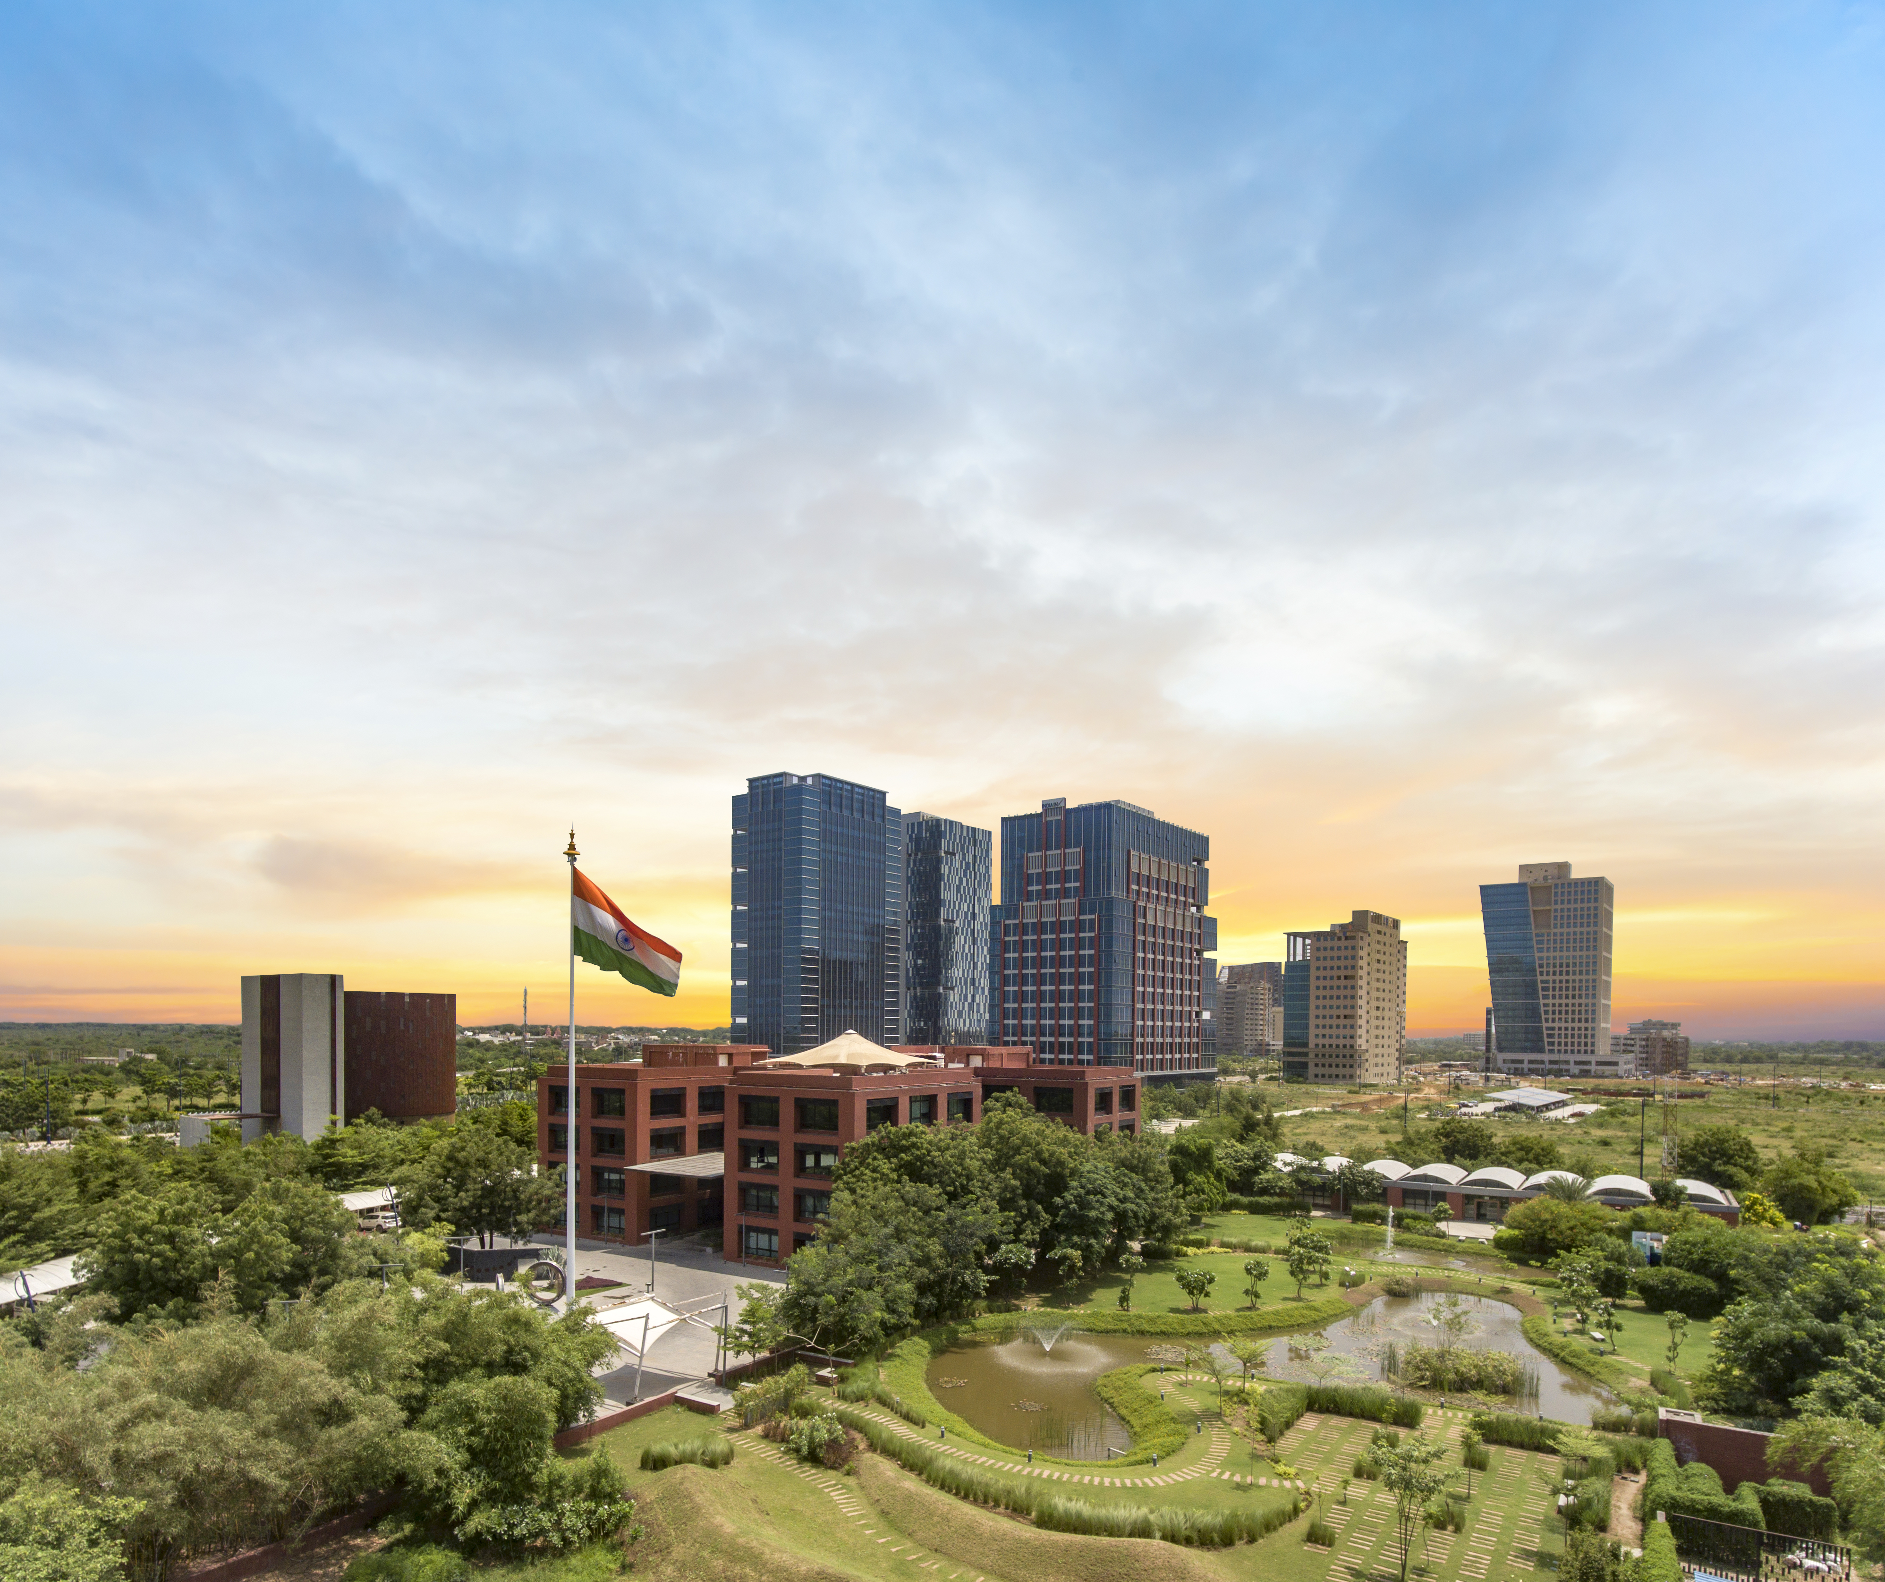
COMPETITIVE TAX REGIME
Overview - IFSC
Tax Holiday on Business Income for 10 out of 15 years
Minimum Alternate Tax* @ 9%
No CTT**/STT**/GST**/Stamp Duty
Reduced Withholding Tax of 4% on interest paid on Debt Instruments
Competitive Tax Regime for AIFs
Incentives under Gujarat IT/ITes Policy
(2022-27)
* MAT provisions not applicable for companies opting for concessional tax rate under Sec. 115 BAA of Income Tax Act, 1961
**CTT- Commodity Transaction Tax, STT- Securities Transaction Tax, GST- Goods and Service Tax
Notes:
GIFT City – Brief

Slide 11
Business Highlights: GIFT IFSC
550 +
$ 67 Bn +
$ 47 Bn +
Number of IFSCA Registered* entities till September 2023
Monthly turnover on IFSC International Stock Exchanges in September 2023
Total Banking Asset Size in September 2023
$ 565 Bn +
6000+
$ 52 Bn +
Cumulative Banking transactions till September 2023
Employment in GIFT SEZ in September 2023
Cumulative Debt Listing on IFSC Exchanges till September 2023
31 +
$ 19 Bn +
$ 675 Bn+
Registered Aircraft and Ship leasing entities till September 2023
Total commitments made to Alternative Investment Funds till September 2023
Cumulative Derivative transactions booked by Banks till September 2023
*Registered, Licensed, Authorized, Notified, etc.

Slide 12
Banking Sector
10 Foreign Banks/MDB
Banks in GIFT IFSC are provide following services:
Banking Branch and Banking Company permitted to set up in IFSC.
IFSCA Banking Handbook: Single source for all banking related regulatory matters.
Minimum regulatory Capital, subject to minimum of USD 20 Mn, which can be maintained at Parent BankPrudential directions of home regulators, unless specified by IFSCA.
Wholesale Banking
Corporate Banking
Retail Banking
Trade Finance
ECB*
ODI**
Acquisition Finance
Loan Syndication
Investment Banking
15 Indian Banks
* External Commercial Borrowing
** Offshore Derivative Instrument

Slide 13
3. Funds Industry:
Globally benchmarked Fund Management Regulations, 2022 provide for the registration of Fund Management Entities (FMEs) ensuring direct oversight over Fund Managers
Three categories of FMEs:
Registered FME (Retail)
Registered FME (Non-Retail)
Authorised FME
GIFT IFSC is emerging as a preferred hub: Venture Capital Funds, Private Equity, Hedge Funds, etc.
Global investors includes Sovereign Wealth funds/pension funds such as ADIA, GIC, Temasek, CPPIB are investing in IFSC Funds
Entire ecosystem present including Trusteeship firms, Custodians, Fund Administrators, Law firms, Auditors etc.
Funds Ecosystem in GIFT IFSC

Slide 14
3. Fund Ecosystem:
AIFs ( Venture Capital Funds, Private Equity Funds & Hedge Funds)
Portfolio Managers/Investment Advisors

Slide 15
4. Insurance & Reinsurance
Regulatory Ecosystem | Business Activities Enabled | Re(insurance) Ecosystem
13 Insurance Regulations notified including: Registration of Insurance Business, 2021 Insurance Intermediary Regulations, 2021 Insurance Web Aggregator, 2022 Insurance Products and Pricing, 2022 Appointed Actuary Regulations 2022 Investment by IIO Regulations 2022 Re-Insurance Regulations 2023 | Internationally aligned insurance regulations for onboarding global industry players. Introduction of new business such as Managing General Agents (MGA) IFSC Insurance Offices permitted to do allied activities related to (re)insurance. Enabling retail participation through Insurance Web Aggregators | Re-insurer: 6 Intermediaries: 21 Gross Premium Booked by IIOs: $ 237 Mn. (Till June 2023) Re(insurance) premium arranged by Insurance intermediaries: $ 738 Mn. (Till June 2023)

Slide 16
9. Ancillary Services Ecosystem
Regulatory Ecosystem
Ancillary Service Framework 2021 enables:
Legal, Compliance and Secretarial;
Auditing, Accounting, Bookkeeping and Taxation Services;
Professional & Management Consulting Services
Assets Management Support Services and Trusteeship Services
Ancillary services can provide services:
IFSC Entities
Entities from foreign jurisdictions
Indian entities who propose to open, set up or carry out operations in IFSCs
50 + Ancillary Services firms have been authorized by IFSCA

Slide 17
SHIP LEASING: SECTORAL LANDSCAPE AND OPPORTUNITY

Slide 18
Maritime Industry in India
80% of global trade (by volume) is carried by maritime transport
95 % of India trade (by volume) is carried by maritime transport
~$ 75 billion of estimated amount of seaborne freight paid to foreign shipping companies
India has ~ 20mn DWT (13.6 GT) or 1% global market share.
(China: 340 DWT/16%)
Source: 1. SAFAL Report, IFSCA

Slide 19
Shipping in India
18th
7517
12
205
1493
12.99m
largest in tonnage
Kms of Coastline
Major Ports
Minor Ports
Merchant marine Fleet*
Gross Tonnage*

Slide 20
SHIP LEASING: PROGRESS AT GIFT IFSC

Slide 21
Timeline on Ship Leasing from IFSC
Sept 2023:
8 entities registered under Ship Leasing Framework
Oct 2021: Report “SAFAL” was released
Jan 2022: Finance Ministry notifies “Ship lease” as a financial product
Aug 2022: IFSCA issues “Framework for Ship Lease”
March 2023:
Amendments in Framework adding operating lease, Voyage chartering, AMS services
Progress so far for Ship Leasing leasing at GIFT IFSC:
8+ Ship lessors registered with IFSCA
IFSCA based Financial Institutions financed the ships owned and leased by IFSC based lessors

Slide 22
IFSCA Ship Lease Regulatory Framework
Operating Lease
Financial Lease
Permissible Activities
Permissible Activities
Operating lease including sale and leaseback, purchase, novation, transfer, assignment, and other similar transactions in relation to ship lease;
Voyage Charters, Contract of Affreightments, employment in shipping pools and all other legal commercial transactions for employment of ships;
Asset Management Support Services for assets owned or leased out by the entity or by its wholly-owned subsidiary(ies) or by the branch of its wholly owned subsidiary set up in IFSC (under the ancillary services framework of IFSCA);
Any other related activity with the prior approval of the IFSCA.
Financial lease or a hybrid of a financial and operating lease;
Permitted activities under the Ship Operating Lease framework;
Any other related activity with the prior approval of the IFSCA.
Capital Requirement
A minimum owned fund of USD 3 million or its equivalent in freely convertible foreign currency
Capital Requirement
General prudential requirements
A minimum owned fund of USD 200,000 or its equivalent in freely convertible foreign currency
a. Capital Ratio: Minimum 8% of regulatory capital to RWA
b. Liquidity Coverage Ratio: LCR on stand-alone basis at all times
c. Exposure Ceiling: 25% of its available eligible capital base

Slide 23
Extended Ecosystem in GIFT IFSC
Services providers - Asset Managers, Ship Brokers, Law firms, Advisory firms
01
Ship Owners
02
Ship Lessors
03
04
Banks and Financial Institutions
Gujarat Maritime University & Gujarat Maritime Cluster
06
International Arbitration Centres
05

Slide 24
GIFT IFSC enablers for Ship Leasing : Non-Tax
Particulars | Units in IFSC
Rule 29 B | Vessel of GIFT IFSC based units are considered to enter GIFT SEZ if they enter any SEZ port in India.
Vessels that are owned by IFSC unit to avail the ROFR preferences vis-à-vis other vessels
Built | Ownership | Flag | Existing order of ROFR | New order of ROFR
Indian | Indian | Indian | I | I
Indian | IFSC | Indian | - | II(New)
Foreign | Indian | Indian | II | III
Foreign | IFSC | Indian | - | IV (New)
Indian | Foreign | Foreign | III | V

Slide 25
SHIP LEASING: TAX REGIME

Slide 26
GIFT IFSC enablers for Ship Leasing : Direct Tax Regime
Particulars | Units in IFSC
Corporate tax rate | Tax holiday for any 10 consecutive years out of the first 15 years
Minimum alternate tax (MAT) /Alternate Minimum Tax AMT | MAT not applicable to companies opting for the new tax regime, else 9%
Withholding tax (WHT) on interest payment | Withholding tax exemption in respect of interest paid to non-residents on monies borrowed on or after 1 September 2019
Capital gains on disposal of ship / ocean vessel | 100% profit linked deduction available on capital gains arising on transfer of ship / ocean vessel leased by IFSC unit to domestic company (provided operations commence before 31 March 2024)
WHT on lease rentals | Withholding tax on lease rentals paid by Indian Lessee to IFSC lessor during the tax holiday period is Nil under IT Act No Withholding tax on ship lease payments, in the nature of royalty or interest, paid to non-residents by units in the IFSC (provided operations commence before 31 March 2024)

Slide 27
GIFT IFSC enablers for Ship Leasing : Indirect Tax Regime
Particulars | Units in IFSC
Input GST | No input GST on goods / services received from India DTA or non-resident vendors
Providing Services to Intra-IFSC/Other SEZs units | No GST to be charged for services provided to other IFSC or SEZ units
Resident entities | GST applicable on supply made to entities in India DTA

Slide 28
Why ship leasing from the IFSC?
Unified regulatory
regime
Competitive
Tax Regime
Liberal policies enabling flow of finance, financial products and services across borders
Deemed foreign jurisdiction – free from exchange control perspective
State-of-the art infrastructure
Skilled talent
Maritime cluster
Maritime university
Maritime ecosystem

